Slide 1
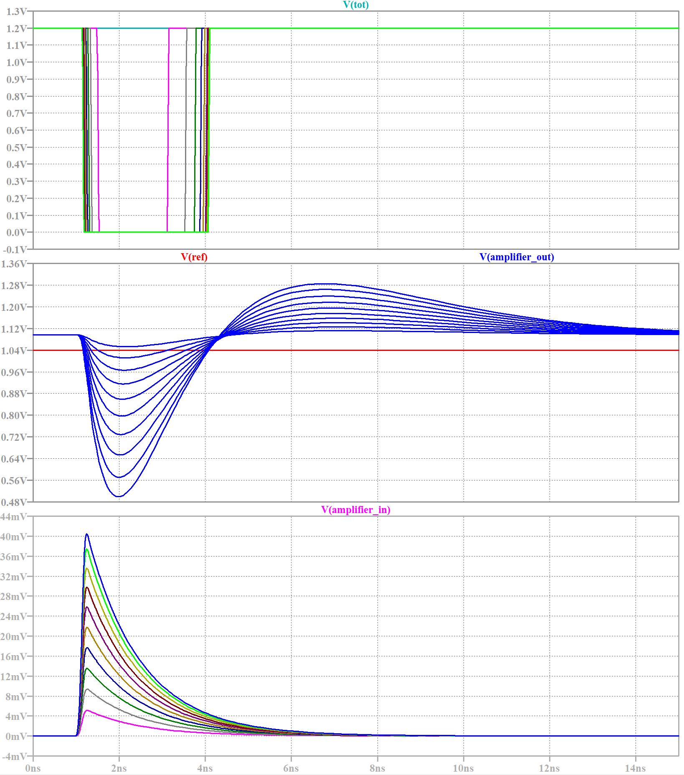
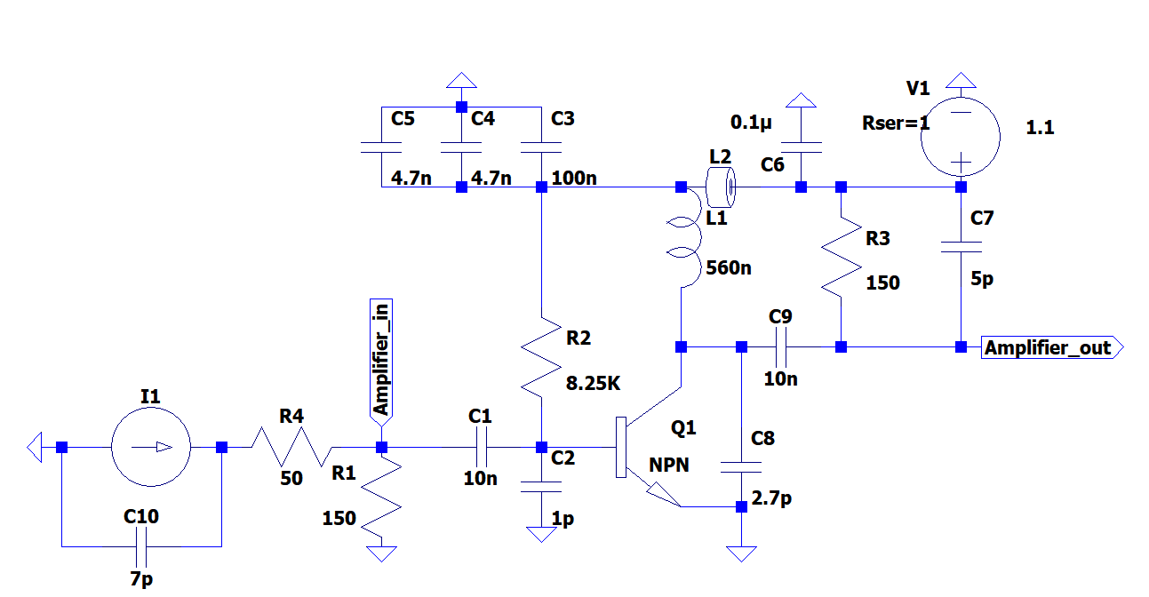
SPICE Simulation Inductive load amplifier
page_48: https://jspc29.x-matter.uni-frankfurt.de/trb/schematics/farich_system.pdf

Slide 2
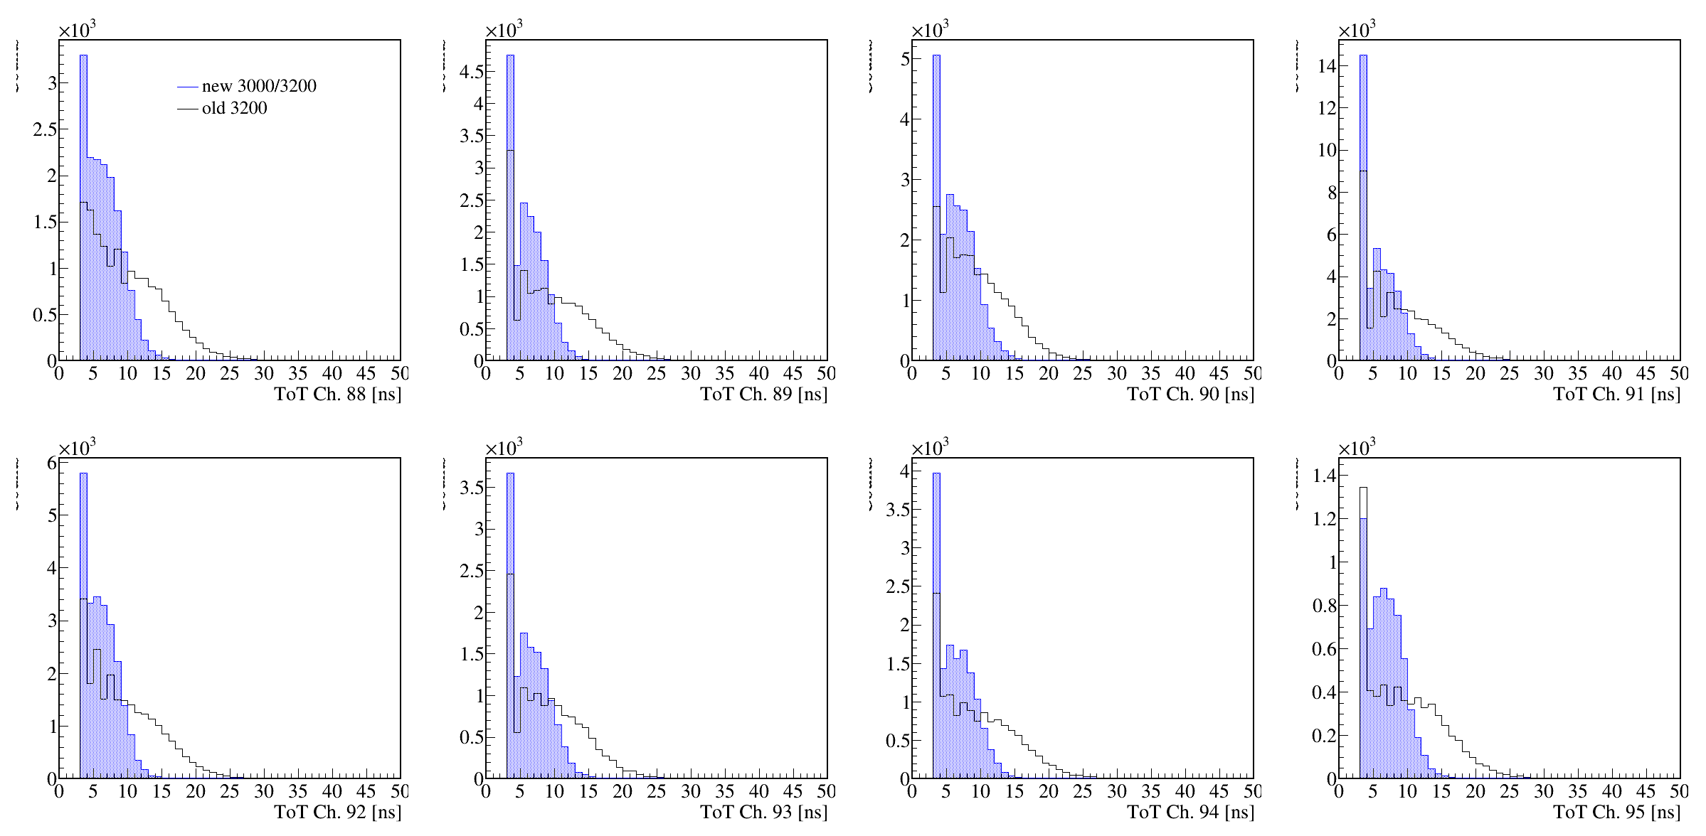
TOT 2.2 uH vs 560 nH

Slide 3
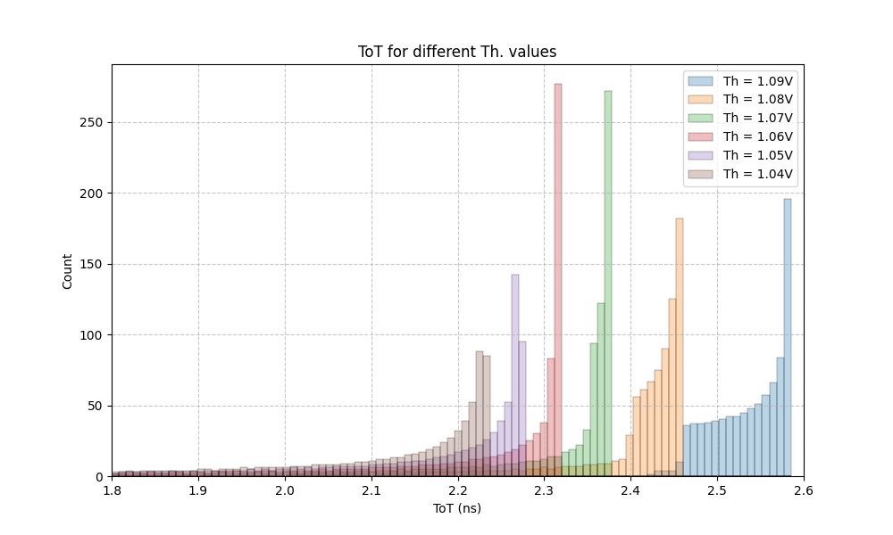
1.09-1.04 V th

Slide 4
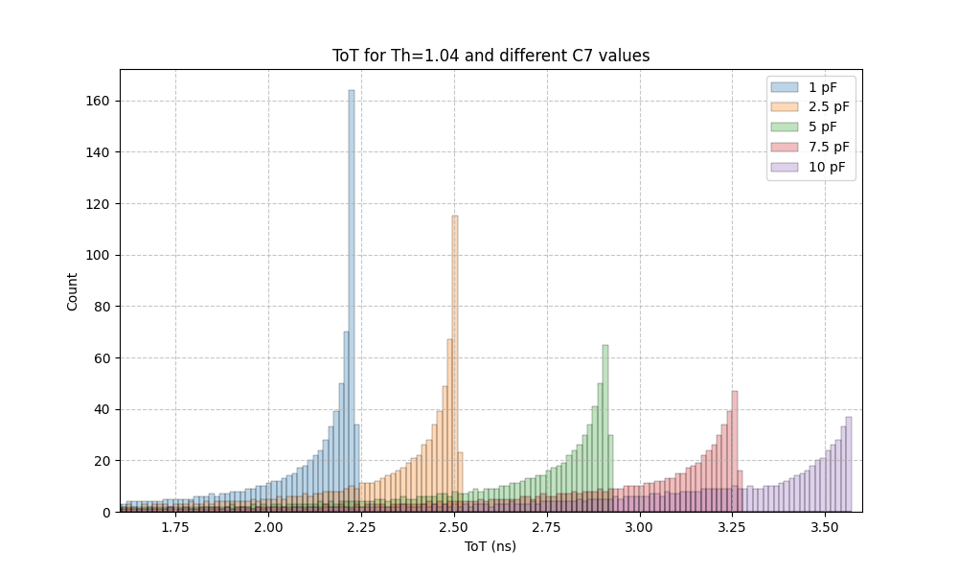
C7 1-10pF

Slide 5
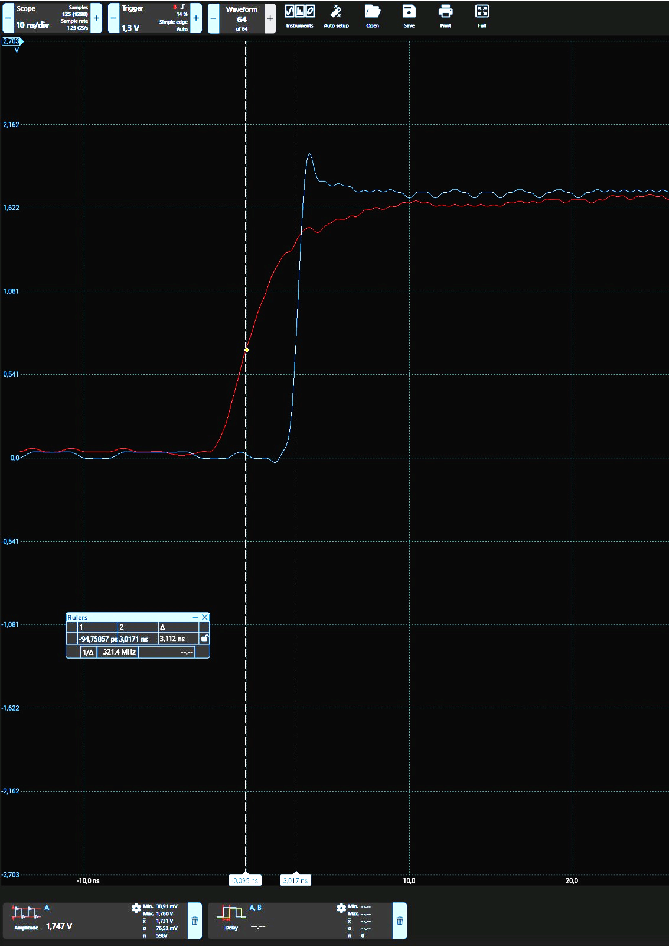
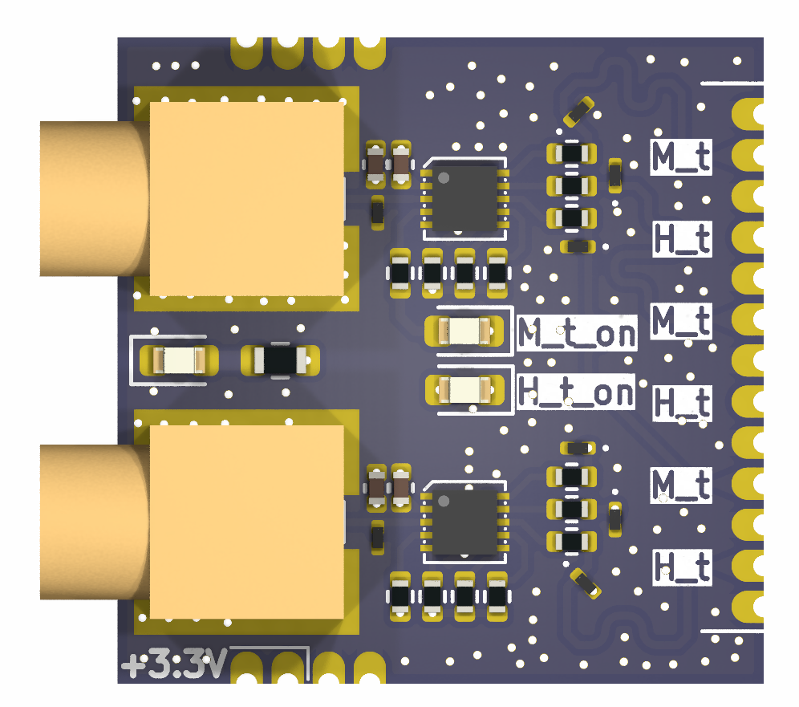
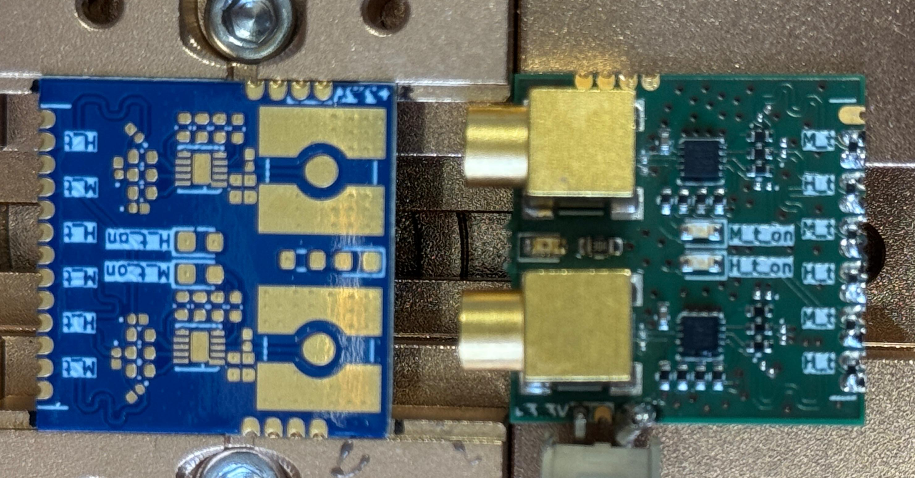
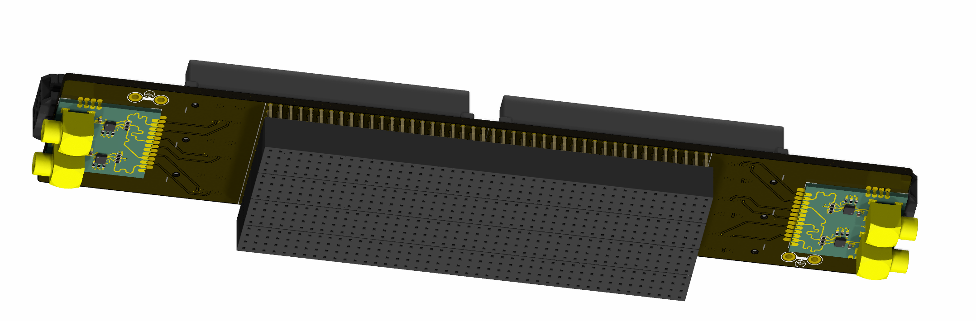
Clock Buffers
2 inputs to 6 outputs for Heimtime and Master trigger

Slide 6
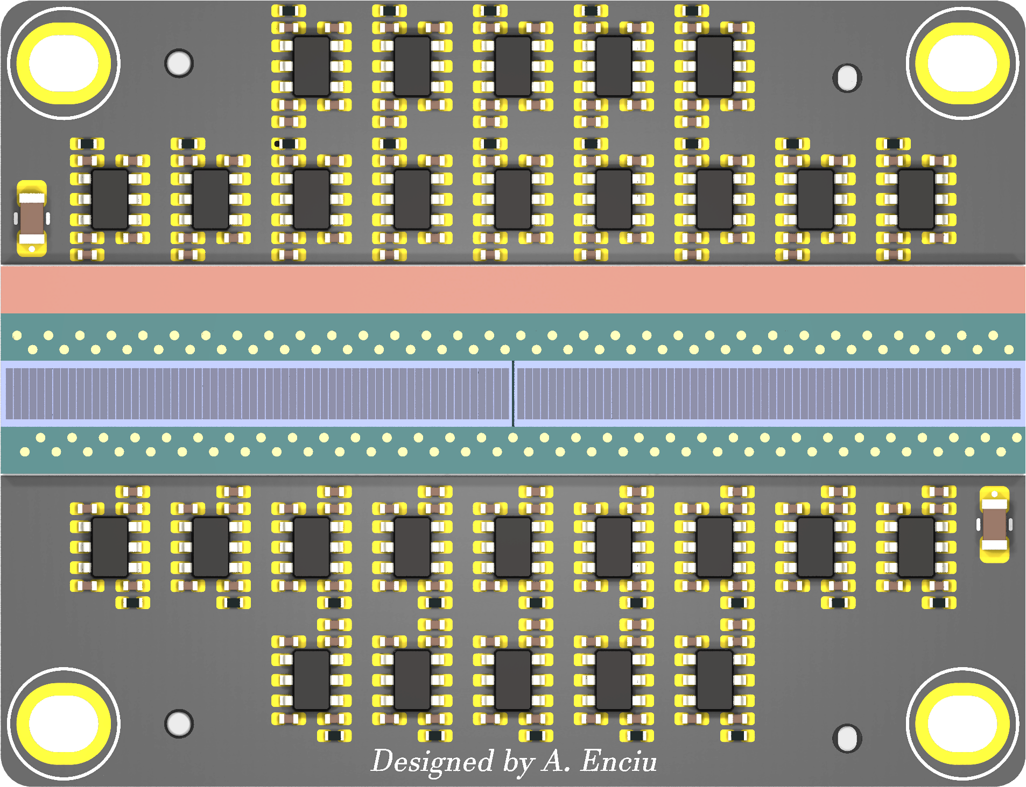
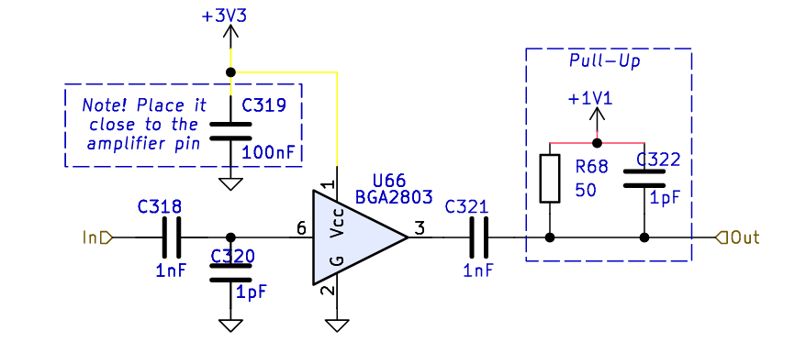
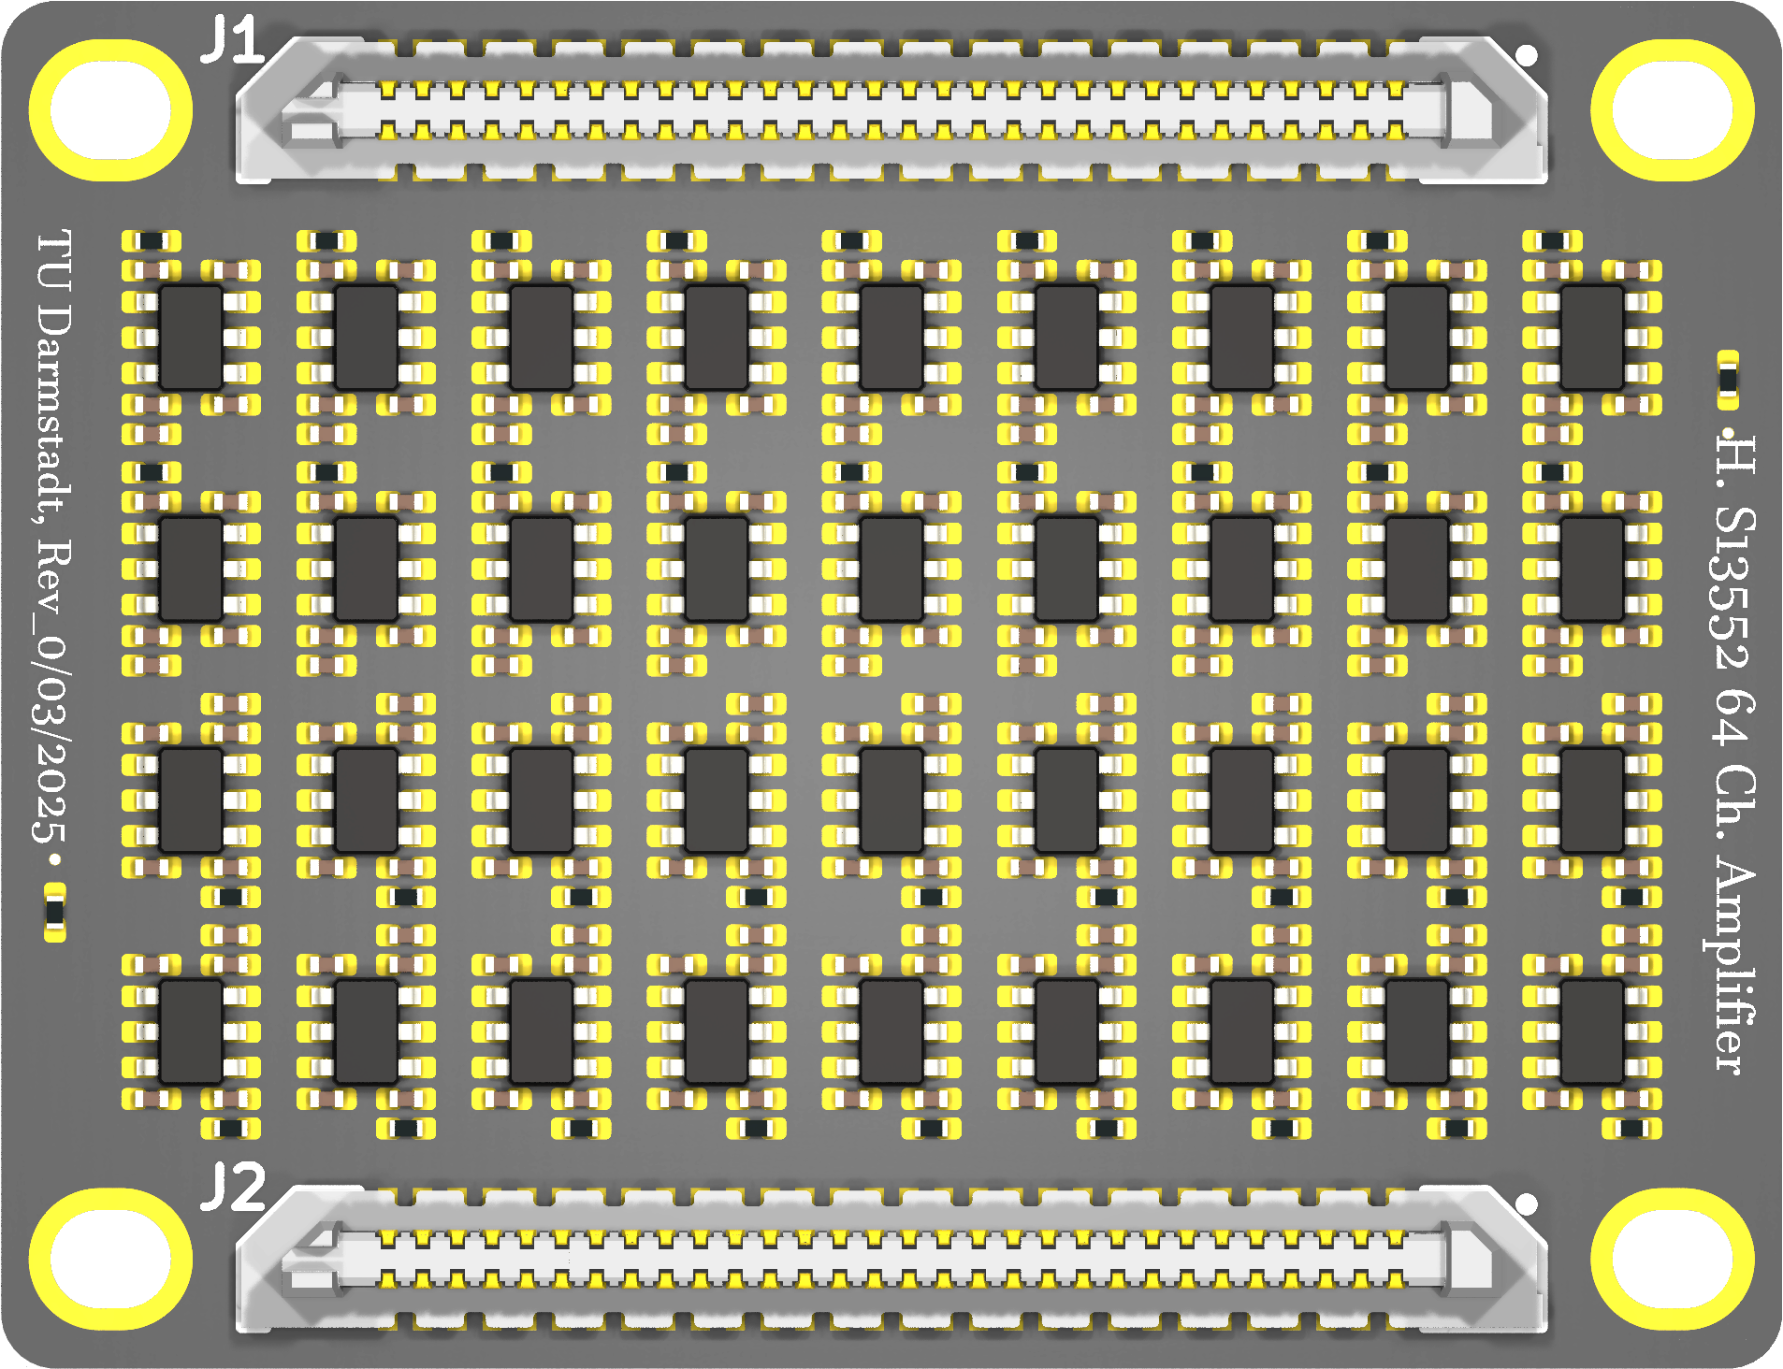
New Amplifier Based on PADIWA3
TOP VIEW
64 channels based on BGA2803 RF amplifier (bw. 2.2GHz)
23.6 dB gain / 3 dB noise 950 Mhz
Cost effective (0.3 euro/pcs)
Simulation - ongoing
BOTTOM VIEW
page_4: https://jspc29.x-matter.uni-frankfurt.de/trb/schematics/PADIWA3-all.pdf
W. Zhi et al 2024 JINST 19 P06011 DOI 10.1088/1748-0221/19/06/P06011
Joshua W Cates et al 2018 Phys. Med. Biol. 63 185022 DOI 10.1088/1361-6560/aadbcd
F. Simon NIM-A Volume 926, 11 May 2019, Pages 85-100 Doi.org/10.1016/j.nima.2018.11.042

Slide 7
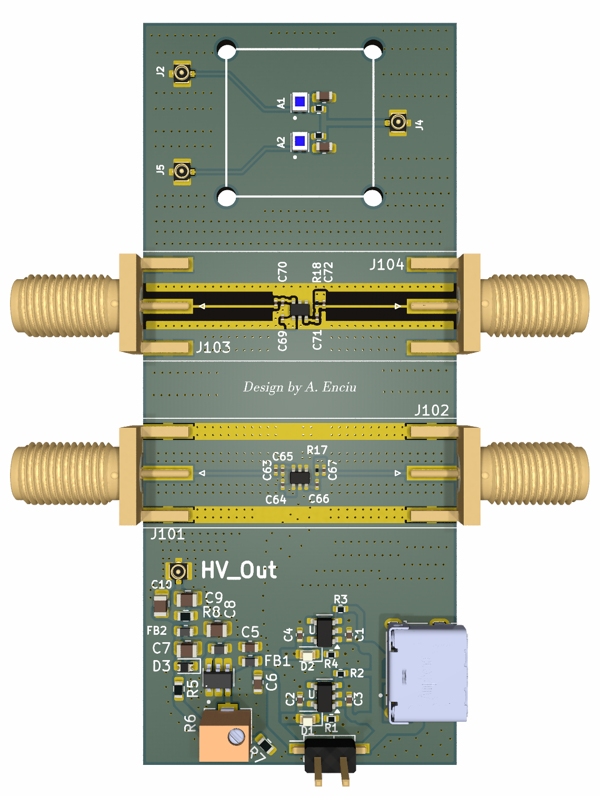
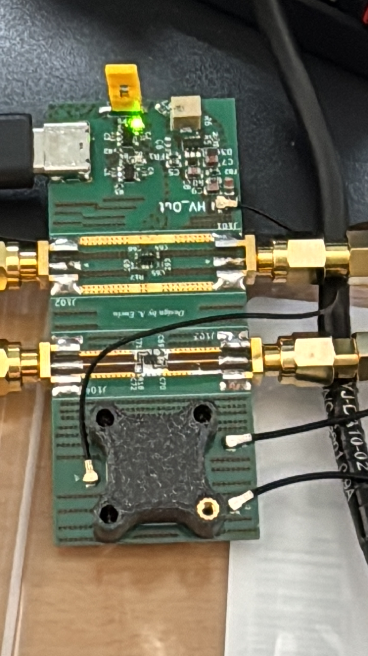
BGA2803 Demo Board
2 RF amplifiers
2 SiPMs
1 HV PSU
Power via USB-C

Slide 8
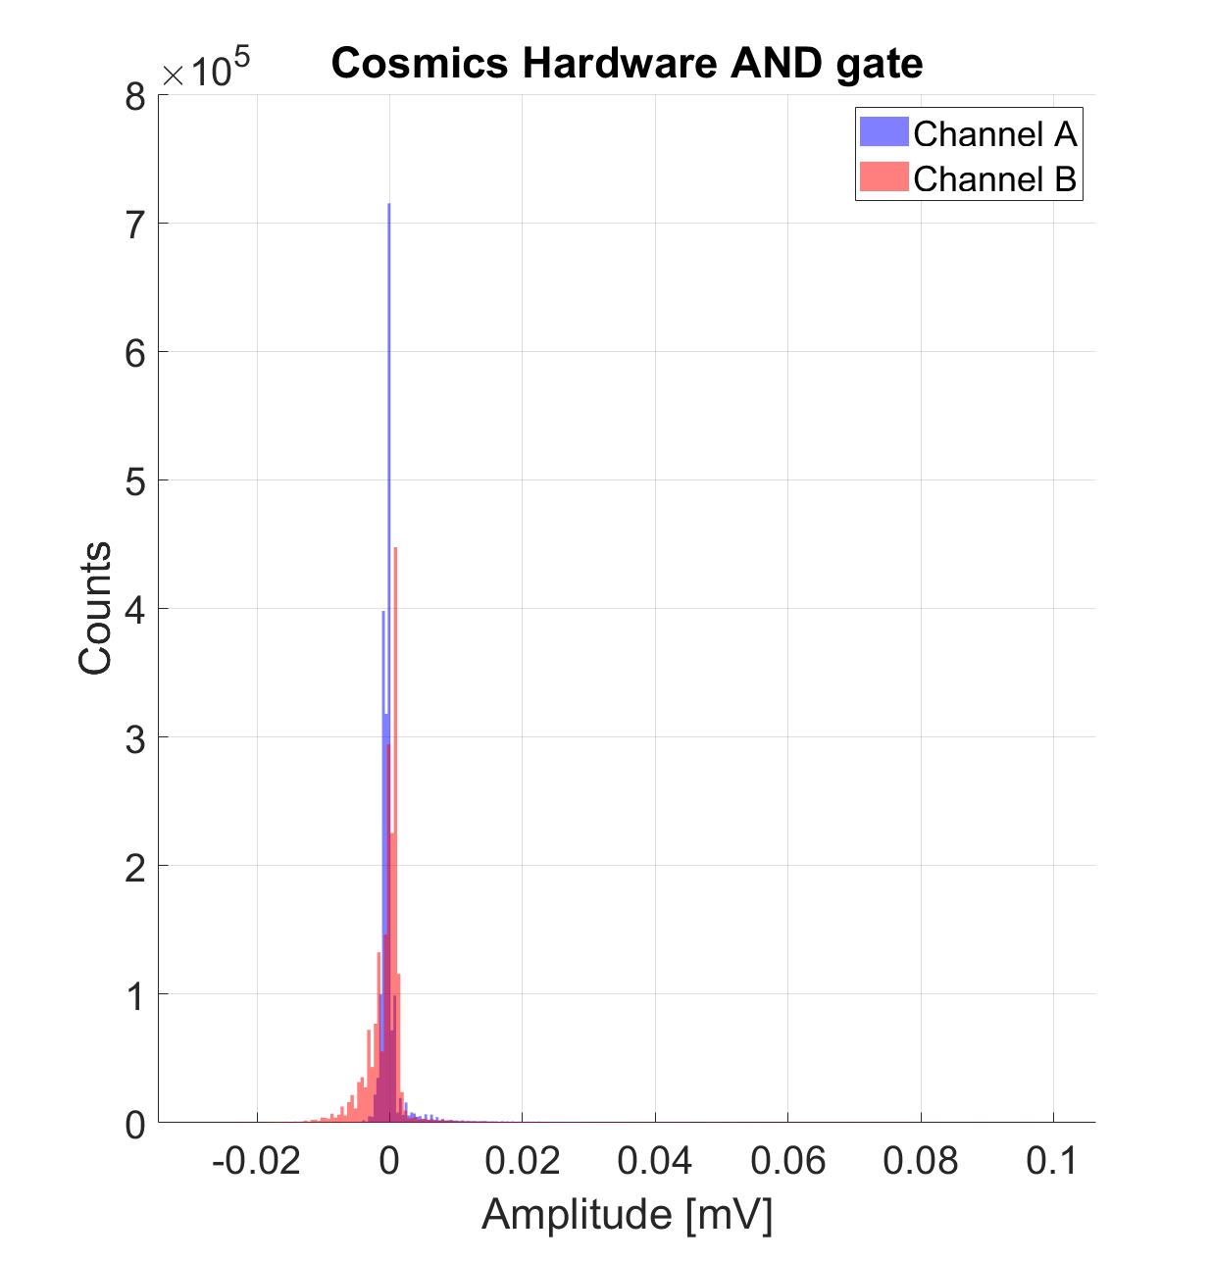
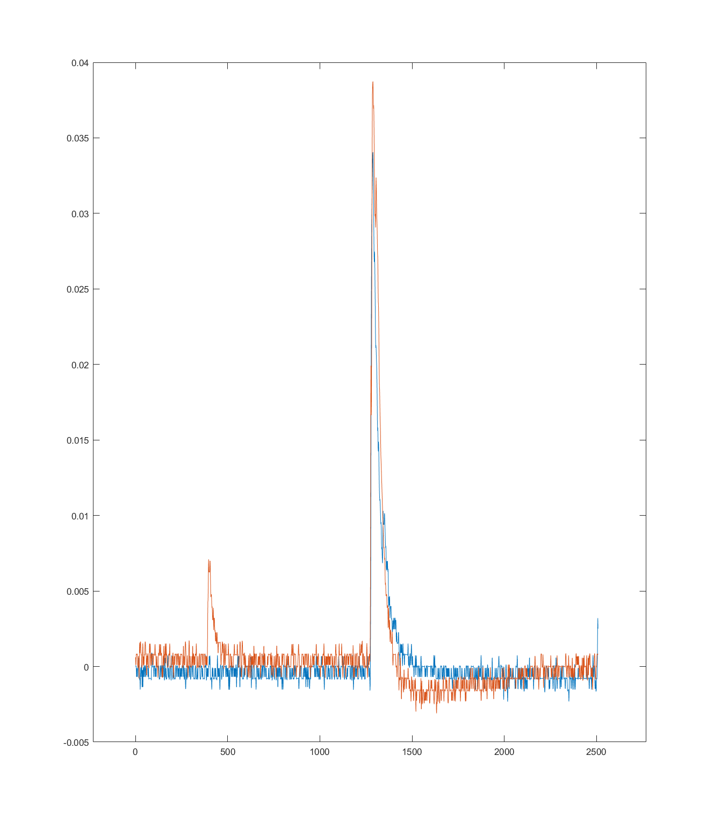
BGA2803 Demo Board
Amplitude (V)
Time (ns)

Slide 9
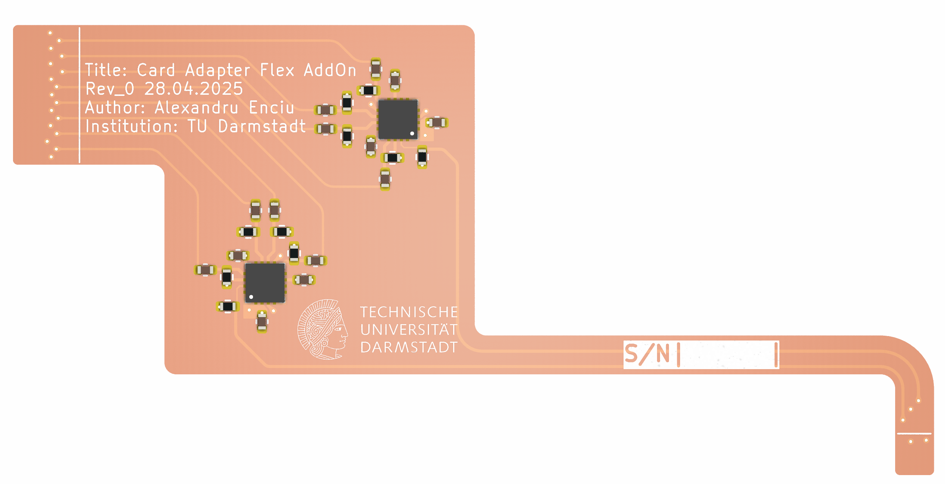
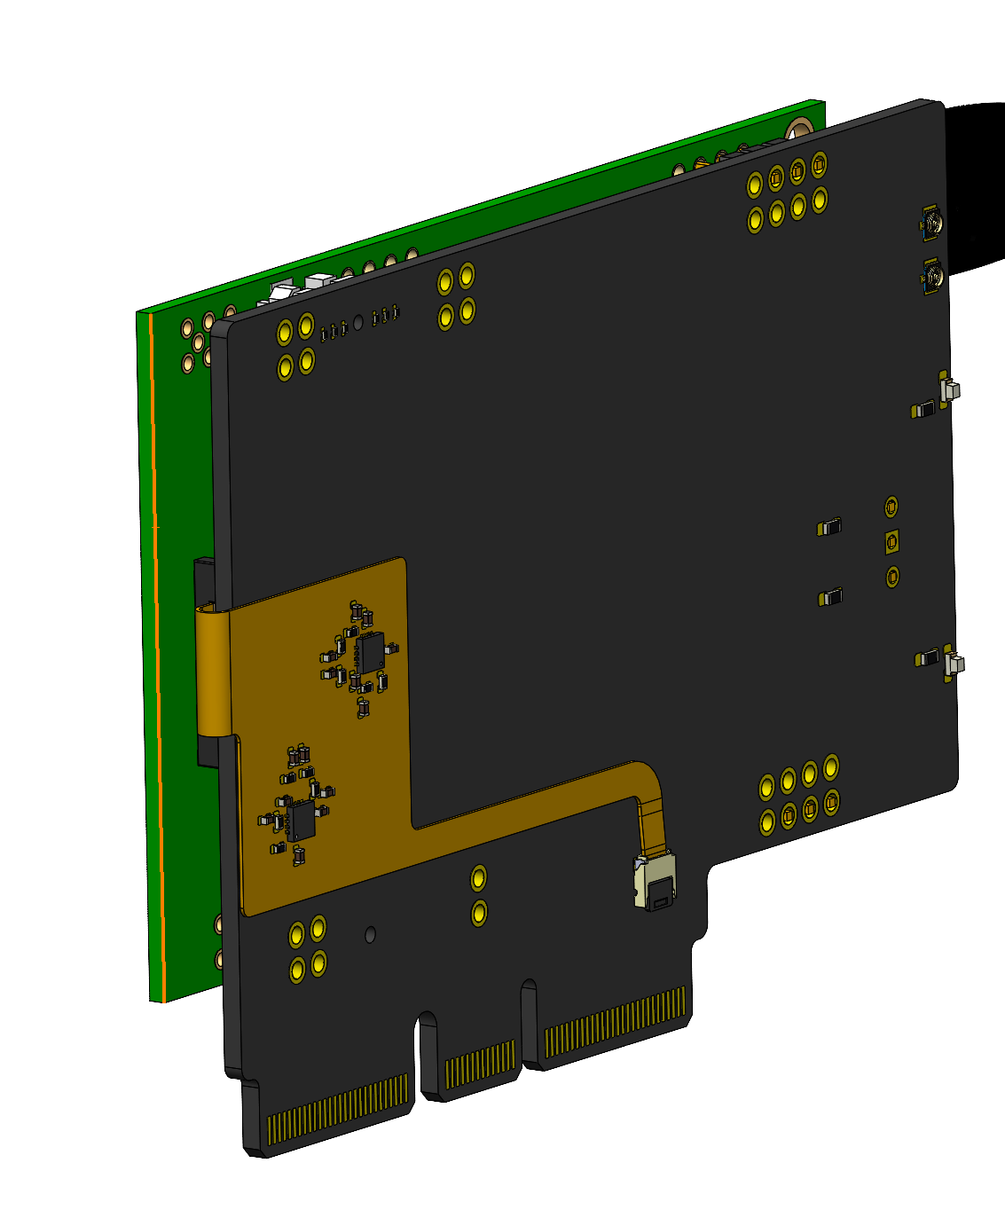
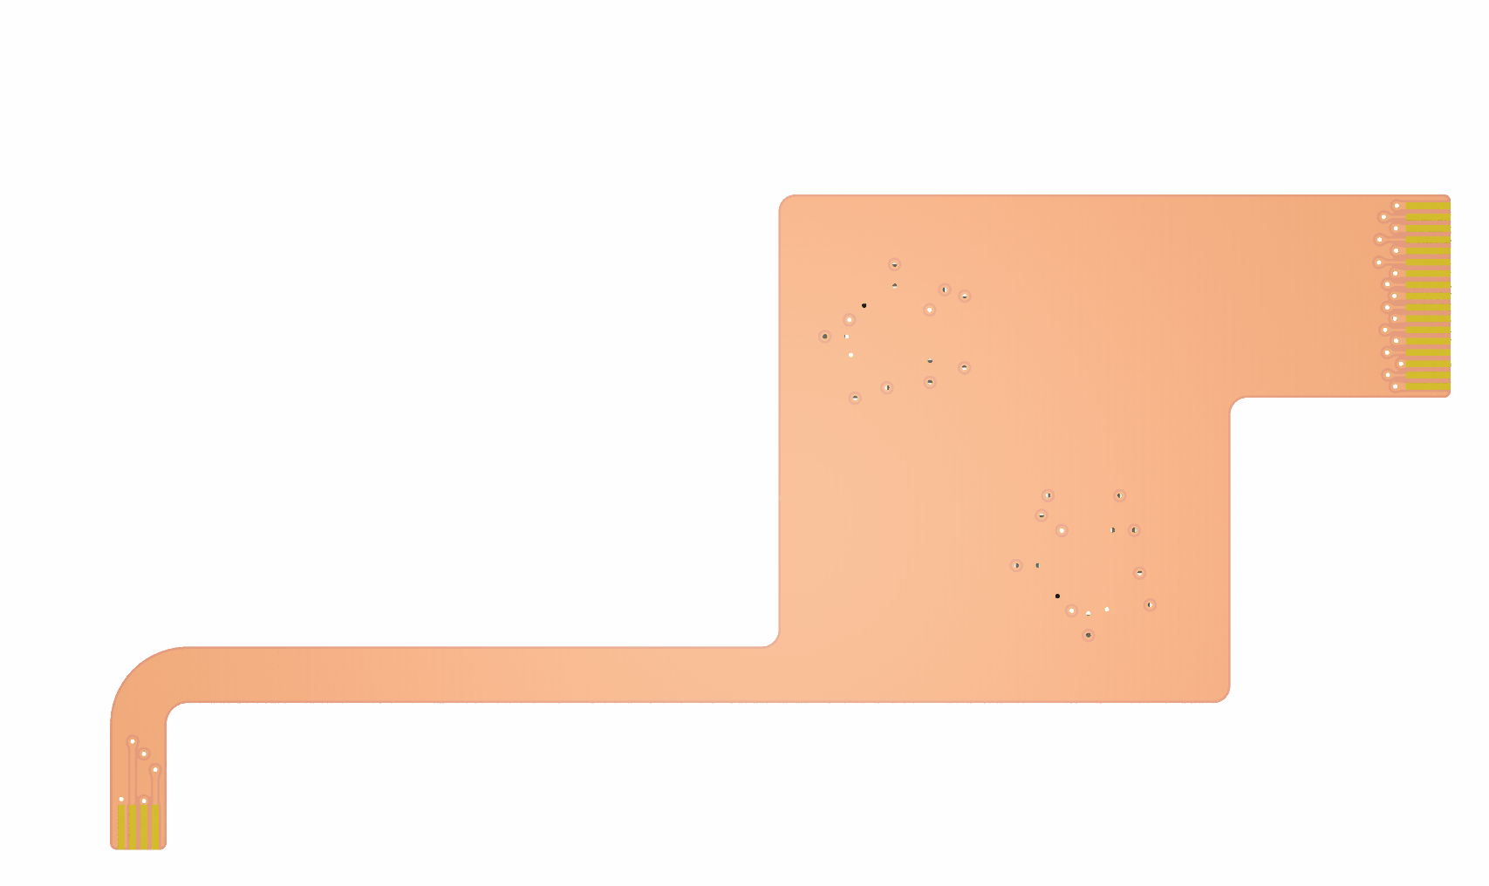
Flex PCB AddOn

